Slide 1

React
Testing React Apps

Slide 2
component = ƒ(props, state)
Notes:
React построен на идее веб компонентов.
Компонент принимает данные на вход в виде props, и генерирует HTML.
Этот простой подход обеспечивает простое тестирование приложений.

Slide 3
The Plan
Test types
What we have to test and what we can not test.
Tools:
Test Frameworks
Assertion Libraries
Where to test
Jest
Helper libraries
React Test Utils
Enzyme
Test Redux/Flux

Slide 4
Test Frameworks
Test Frameworks
Mocha
Jasmine
Jest
Tape
AVA
Assertion Libraries
Expect
Should
Assert
Chai
...
Notes:
-- framework-independent:
Mocha - Mature, most popular, highly configurable, large community
Jasmine - very similar to Mocha
-- related to React:
Jest - from Facebook, based on Jasmine, has some specific features for testing React. Interestingly, but it’s not the most popular for testing React.
--others:
Tape - the minimal, the simplest on the list
AVA - concurrent test run

Slide 5
Where to run tests?
Real browsers
Headless browser (PhantomJS)
JSDOM
Node Environment

Slide 6

Jest
Jest is a bit different from most test runners. Facebook designed it to work well in the context of it's infrastructure:
Monorepo
Sandboxing
providesModule
Error messages are helpful and color coded. Stack traces point to the source of problems quickly
Integrated support for testing with promises and async/await
Jest runs previously failed tests first. Together with --bail it provides useful signal quickly
Integrated manual mocking library
Automatically find tests related to changed files to execute in your project with -o
Run tests in parallel processes to minimize test runtime
Notes:
Monorepo At Facebook we have a huge monorepo that contains all of our JavaScript code
Sandboxing Another feature of Jest that's important to Facebook is how it virtualizes the test environment and wraps require in order to sandbox code execution and isolate individual tests
providesModule If you've looked at any of our open source JavaScript projects before, you may have noticed that we use a @providesModule header to assign globally unique IDs to modules. This does require some custom tooling, but it allows us to reference modules without relative paths which has helped us move incredibly fast, has scaled well as our engineering organization has grown, and has fostered code sharing across the entire company

Slide 7
Jest. Describe, it
// math.test.js
import { increment, add } from './math';
describe('math.js', () => {
it('should increment',
() => expect(increment(1)).toBe(2));
it('should add',
() => expect(add(2, 3)).toBe(5));
});
// math.js
export function increment(n) {
return ++n;
}
export function add(a, b) {
return a + b;
}
Notes:
Nothing new here, if you’ve already worked with jasmine/mocha: describe (used to logically group tests) and it to wrap test.

Slide 8
Jest. Assertions
describe('math.js', () => {
it('should have add method',
() => expect(add).toBeDefined());
describe('nonExistingMethod', () => {
it('should not exists',
() => expect(nonExistingMethod).not.toBeDefined());
it('should throw',
() => expect(() => nonExistingMethod()).toThrow());
});
});

Slide 9
Jest. Mock, Spy
// mock.test.js
import { functionWithCallback } from './mock';
describe('mock', () => {
jest.useFakeTimers();
it('should execute callback', () => {
const cb = jest.fn();
functionWithCallback(cb);
jest.runAllTimers();
expect(cb).toHaveBeenCalled();
expect(setTimeout.mock.calls[0][1]).toBe(1000);
});
});
// mock.js
export function functionWithCallback(cb) {
setTimeout(cb, 1000);
}

Slide 10
Jest. Async / Promises
// async.test.js
import { ajaxGet } from './async';
describe('ajax', () => {
it('should return some data', () => {
return ajaxGet('/known-endpoint')
.then(data => expect(data).toBe('Some data'));
});
it('should return error on other endpoints', () => {
return ajaxGet('/other')
.catch(data => expect(data).toBe('Error!'));
});
});
// async.js
export function ajaxGet(url) {
return new Promise((resolve, reject) => {
url === '/known-endpoint'
? resolve('Some data')
: reject('Error!');
});
}
Notes:
Usually our code has not just timeouts, but it has some async ajax call.

Slide 11
Jest. Mock modules
// http.service.js
export function getJson(url) {
return fetch(url, {
credentials: 'same-origin',
headers: {
Accept: 'application/json',
'Content-Type': 'application/json',
}
});
}
// user.service.js
import { getJson } from './http.service';
export function getUser(id) {
return getJson(`/users/${id}`);
}

Slide 12
Jest. Mock modules
describe('user.service', () => {
const getJsonMock = jest.fn()
.mockReturnValue(Promise.resolve('User'));
jest.mock('./http.service', () => ({
getJson: getJsonMock
}));
const getUser = require('./user.service').getUser;
it('should request user by /user/:id', () => {
return getUser(1).then(
() => expect(getJsonMock).toHaveBeenCalledWith('/users/1'));
});
});
Notes:
Angular implemented DI to make it more testable. With jest you can easily mock modules also!

Slide 13
Jest. Lifecycle method
afterEach(function () {
jest.resetAllMocks();
jest.clearAllTimers();
});

Slide 14
Jest. React Snapshot Testing
// my-component.js
import React from 'react';
const MyComponent = ({ title, children }) => (
<section>
<header>{title}</header>
<p>{children}</p>
</section>
);
export default MyComponent;
// my-component.test.js
import React from 'react';
import renderer from 'react-test-renderer';
import MyComponent from './my-component';
it('should be rendered correctly', () => {
const component = renderer.create(
<MyComponent title="some title">
some content
</MyComponent>
);
const tree = component.toJSON();
expect(tree).toMatchSnapshot();
});

Slide 15
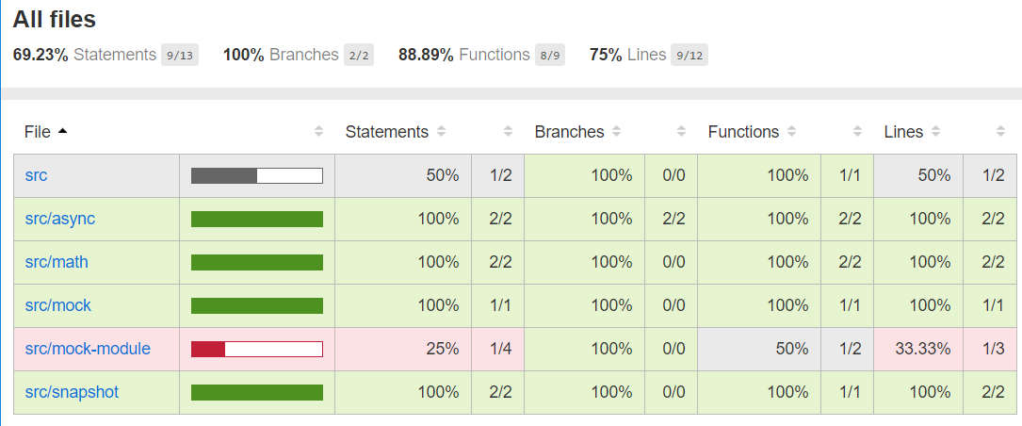
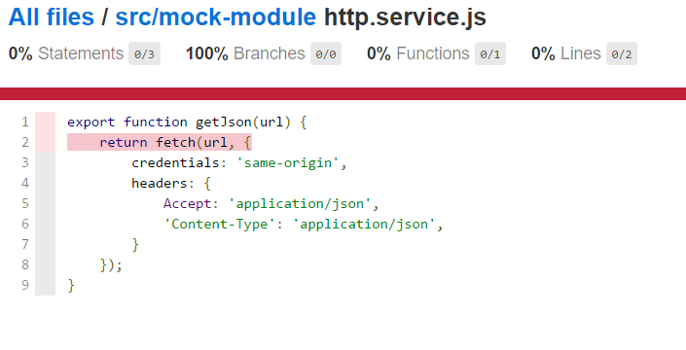
Jest. Coverage

Slide 16
questions

Slide 17
Helper Libraries
React Test Utils
Enzyme

Slide 18

React Test Utils
Rendering the component
Querying rendered components
Assertions on a component
Simulate events

Slide 19
React Test Utils
class CheckboxWithLabel extends React.Component {
...
render() {
return (
<label>
<input
type="checkbox"
checked={this.state.isChecked}
onChange={this.onChange}
/>
{this.state.isChecked ? this.props.labelOn : this.props.labelOff}
</label>
);
}
}
import React from 'react';
import ReactTestUtils from 'react-addons-test-utils';
import CheckboxWithLabel from './CheckboxWithLabel';
describe('CheckboxWithLabel', () => {
it('should display labelOff by default', () => {
//Arrange
const renderer = ReactTestUtils.createRenderer();
//Act
renderer.render(<CheckboxWithLabel labelOff="Off" labelOn="On" />);
const result = renderer.getRenderOutput();
//Assert
expect(result.type).toBe('label');
const label = result.props.children[1];
expect(label).toEqual('Off');
});
});

Slide 20
React Test Utils: Render Options
Shallow Render
Render component one level deep
No DOM required
Fast and simple
Does not support refs
Does not support event simulation
Component lifecycle limitations
Render into DOM
Render component and children
Requires DOM
Supports interactions

Slide 21
Shallow Rendering
function MyComponent() {
return (
<section>
<span className="heading">Title</span>
<Subcomponent foo="bar" />
</section>
);
}
function Subcomponent({foo}) {
return (
<section>{foo}</section>
);
}
test('Shallow render should render one level deep', () => {
//Arrange
const renderer = ReactTestUtils.createRenderer();
//Act
renderer.render(<MyComponent />);
const result = renderer.getRenderOutput();
//Assert
expect(result.type).toBe('section');
expect(result.props.children[0].type).toBe('span');
expect(result.props.children[1]).toEqual(<Subcomponent foo="bar" />);
});

Slide 22
renderIntoDocument
import React from 'react';
import ReactTestUtils from 'react-addons-test-utils';
import CheckboxWithLabel from '../components/CheckboxWithLabel';
describe('CheckboxWithLabel', () => {
it('should update label on change', () => {
//Arrange
const component = ReactTestUtils.renderIntoDocument(<CheckboxWithLabel labelOn="On" labelOff="Off" />);
const checkbox = ReactTestUtils.findRenderedDOMComponentWithTag(component, 'input');
const span = ReactTestUtils.findRenderedDOMComponentWithTag(component, 'span');
//Act
ReactTestUtils.Simulate.change(checkbox);
//Assert
expect(span.textContent).toBe('On');
});
});

Slide 23
React Test Utils API
shallowRenderer.render()
renderIntoDocument()
Simulate
isElement()
isElementOfType()
isDOMComponent()
isCompositeComponent()
isCompositeComponentWithType()
findAllInRenderedTree()
scryRenderedDOMComponentsWithClass()
findRenderedDOMComponentWithClass()
scryRenderedDOMComponentsWithTag()
findRenderedDOMComponentWithTag()
scryRenderedComponentsWithType()
findRenderedComponentWithType()

Slide 24
questions

Slide 25
Enzyme
React Test Utils
findAllInRenderedTree()
scryRenderedDOMComponentsWithClass
findRenderedDOMComponentWithClass()
scryRenderedDOMComponentsWithTag()
findRenderedDOMComponentWithTag()
scryRenderedComponentsWithType()
findRenderedComponentWithType()
Enzyme
find

Slide 26
Enzyme = RTU + Cheerio

Slide 27
Testing with Enzyme
import React from 'react';
import { shallow } from 'enzyme';
import CheckboxWithLabel from './CheckboxWithLabel';
describe('<CheckboxWithLabel />', () => {
it('should update label on change', () => {
//Arrange
const component = shallow(<CheckboxWithLabel labelOff="Off" labelOn="On" />);
expect(component.find('span').text()).toBe('Off');
//Act
const checkbox = component.find('input');
checkbox.simulate('change');
//Assert
expect(component.find('span').text()).toBe('On');
});
});

Slide 28
Enzyme Rendering
Shallow Rendering
import { shallow } from 'enzyme';
const wrapper = shallow(<MyComponent />);
// ...
Full Rendering
import { mount } from 'enzyme';
const wrapper = mount(<MyComponent />);
// ...
Static Rendering
import { render } from 'enzyme';
const wrapper = render(<MyComponent />);
// ...

Slide 29
Enzyme Wrapper APIs
.find(selector)
.hasClass(className)
.is(selector)
.children()
.parent()
.closest(selector)
...

Slide 30
Enzyme integrates with...
chai-enzyme with Mocha/Chai
jasmine-enzyme with Jasmine
jest-enzyme with Jest
...

Slide 31
questions

Slide 32

Redux testing. Actions creators
// action-creator.js
let id = 0;
export function addTodo(text) {
return {
type: 'add_todo',
payload: {
id: id++,
text
}
}
}
// action-creator.test.js
import { addTodo } from './action-creator';
describe('action-creators', () => {
it('should return todo with passed text and generated id', () => {
const text = 'write test';
const addTodoAction = addTodo(text);
expect(addTodoAction.type).toBe('add_todo');
expect(typeof addTodoAction.payload.id).toBe('number');
expect(addTodoAction.payload.text).toBe(text);
});
});

Slide 33
Redux testing. Reducers
Big example, go to IDE...

Slide 34
Examples
Can be found here https://github.com/kitos/react-testing
Useful links
http://redux.js.org/docs/recipes/WritingTests.html
https://facebook.github.io/jest/#getting-started
http://airbnb.io/enzyme/index.html
https://facebook.github.io/react/docs/test-utils.html

